Slide 1

CAR PARKING MANAGEMENT SYSTEM
by
BHUVISHA GOHIL
150096725190

Slide 2

Problem Statement
Parking management has become an important issue in busy places such as shopping malls, offices, universities, and public areas. When parking is managed manually, it can lead to several problems such as difficulty in tracking available parking slots, confusion in assigning slots to vehicles, and errors in calculating parking charges.
Manual systems also make it hard to maintain proper records of vehicles entering and leaving the parking area. This can cause inefficiency and delay in managing parking operations.
To solve these problems, a Car Parking Management System is developed using the C++ programming language. The system automates the process of parking slot allocation, vehicle tracking, and parking fee calculation.
The system aims to provide a simple and efficient solution that can:
Automatically allocate available parking slots
Keep track of vehicles entering the parking area
Record entry and exit time of vehicles
Calculate parking fees based on parking duration
Display the status of parking slots
This system helps in improving parking management and reducing manual work.

Slide 3
2. Solution
The Parking management has become an important issue in busy places such as shopping malls, offices, universities, and public areas. When parking is managed manually, it can lead to several problems such as difficulty in tracking available parking slots, confusion in assigning slots to vehicles, and errors in calculating parking charges.
Manual systems also make it hard to maintain proper records of vehicles entering and leaving the parking area. This can cause inefficiency and delay in managing parking operations.
To solve these problems, a Car Parking Management System is developed using the C++ programming language. The system automates the process of parking slot allocation, vehicle tracking, and parking fee calculation.
The system aims to provide a simple and efficient solution that can:
Automatically allocate available parking slots
Keep track of vehicles entering the parking area
Record entry and exit time of vehicles
Calculate parking fees based on parking duration
Display the status of parking slots
This system helps in improving parking management and reducing manual work.

Slide 4
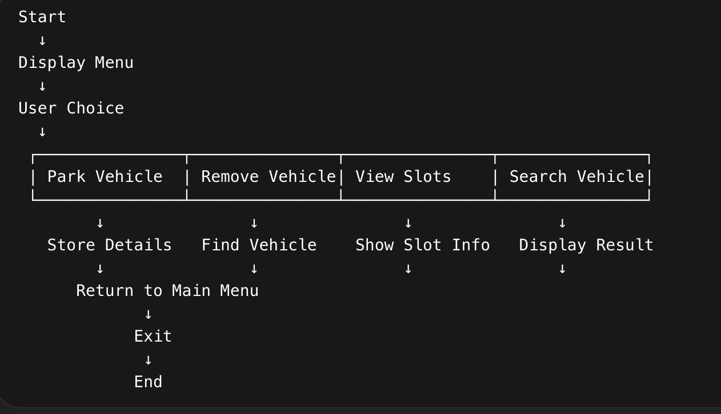
3. Working/Methods & Algorithms.
The Car Parking Management System works using a menu-driven program. When the program starts, the user can choose different operations from the menu.
1. Park Vehicle
User enters vehicle number and parking hours.
System finds the first available parking slot.
Entry time is recorded automatically.
Parking fee is calculated based on hours.
2. Remove Vehicle
User enters vehicle number.
System searches the vehicle in the parking slots.
Slot is released and parking fee is displayed.
Exit time is also recorded.
3. View Slots
Displays all parking slots.
Shows whether each slot is occupied or available.
4. Search Vehicle
Finds the slot where a vehicle is parked.
Parking records are also stored in parking_records.txt using file handling.

Slide 5
4. Conclusion
The Car Parking Management System helps in managing parking slots in an organized and efficient way.
The system can:
Automatically allocate parking slots
Track vehicle entry and exit time
Calculate parking fees based on parking hours
Display parking slot availability
Search for parked vehicles
This project demonstrates the use of C++ programming, object-oriented concepts, time functions, and file handling to manage a real-world parking system.

Slide 6
Thank You

